Slide 1




Building Performant VR Applications for Multi-Domain Modeling and Simulation
Josh Klint, Leadwerks Software, ATA Aerospace
Doyle Towles, Peraton
Ben Gavares, Northrop Grumman
Michael Juliano, Northrop Grumman

Slide 2
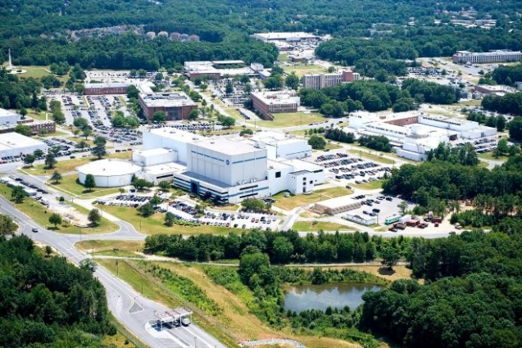
The Problem
Games
  Usually use 32-bit floating point precision
  Polygon counts are determined by the target hardware
  Content is optimized to fit polygon budget
Space simulations
  Require 64-bit floating point precision
  Polygon counts are determined by real objects
  Engineering requires minute details and high-precision data
  Important details cannot be “optimized” away
VR amplifies the problem
  90-144 refresh frequency, instead of 60
  Rendering must be performed twice in 6.9 milliseconds,
  instead of once in 16.7 milliseconds
  Slow framerates cause motion sickness
Goddard Space Flight Center
NASA model of ISS (2.2 million
polygons, 1314 sub-objects)

Slide 3
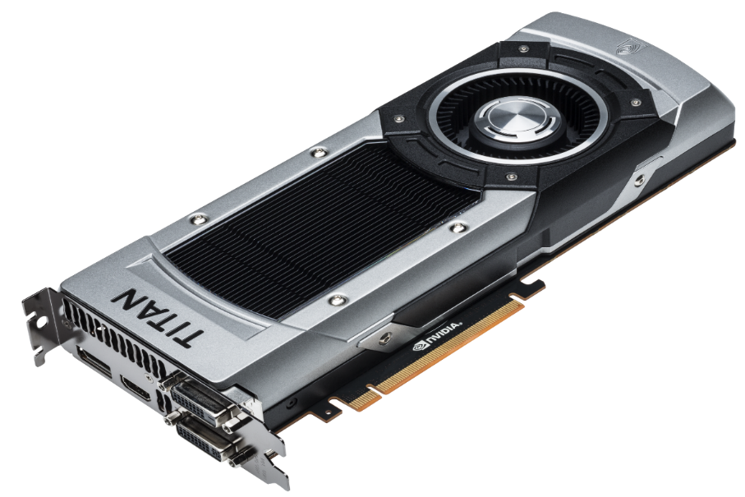
Hardware Analysis
Processing power is increasing faster than memory speed
  GPU processing core counts have increased 10x
  Memory speed has increased 3x
Support for complex shader logic has improved significantly
  Branching if statements
  Variable-length for loops
  Creative use of buffer offsets
Many real-time renderers exhibit low GPU utilization
  “GPU starvation” occurs when the CPU can’t keep up with the GPU

Slide 4
Hardware Analysis

Slide 5
Hardware Analysis

Slide 6
GPU Starvation

Slide 7
Renderer Design Directives
Reduce memory bandwidth
  Compress data
  Store more data persistently in video memory
  Update data less frequently
Increase reliance on complex shader logic
  Early Z-pass discards overlapping pixels
Make better utilization of multicore processors to prevent GPU starvation

Slide 8
Renderer Implementation
Multithreaded architecture
  Minimize processing time on rendering thread
  Goal: Prevent GPU starvation (100% GPU utilization)
  Renderer interpolates between previous two frames of data received from logic thread
  Increased latency isn’t actually a problem
  VR headset and controller orientations updated in rendering thread
Logic
(60 Hz)
Animation
(60 Hz)
Rendering
(90-144+ Hz)
Culling
(45 Hz)
GPU

Slide 9
Renderer Implementation
Culling
  Culling is updated at a slower frequency
  Visibility sets may be reused to render several frames
  Swept frustum can be used to account for camera motion

Slide 10
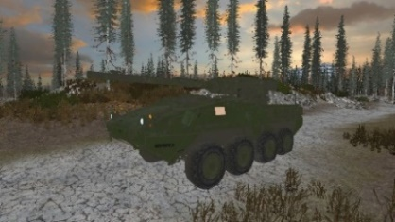
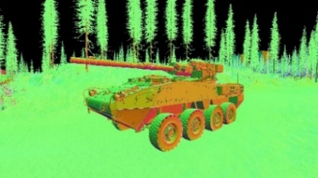
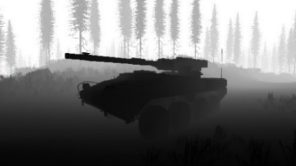
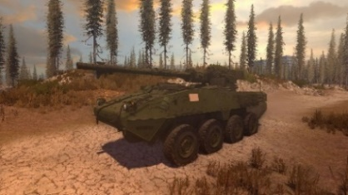
Renderer Implementation
Lighting
  Switch from deferred lighting to forward clustered rendering
Deferred rendering is a high-bandwidth technique

Slide 11
Renderer Implementation
Clustered forward lighting
  More complex shaders
  No need for deferred G-buffer
  Higher computational cost, lower memory bandwidth
  Bonus: Transparency works great with lighting!
Clustered forward rendering is a low-bandwidth technique

Slide 12
Renderer Implementation
Animation
  Half-float data type used for bone orientations
  Each bone has a position, uniform scale, and quaternion
  Sent to GPU at game loop frequency (60 Hz) and interpolated between current and previous frame
  Higher computational cost, lower memory bandwidth
 | Skeletons | Bones | Bytes per bone | Frequency | Data (Mb/s)
Original | 1000 | 256 | 64 | 144 | 2250
Compressed | 1000 | 256 | 16 | 60 | 234

Slide 13
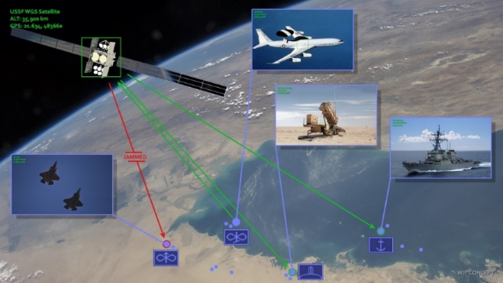
Renderer Implementation
Large-scale simulations
  Representation of detailed objects with millimeter precision, throughout the solar system
  Multi-domain simulation with tracking and visualization of land, air, sea, and space assets in real-time
  Required 64-bit floats, doubling memory usage for object orientations
Multi-Domain simulation, with insets of selected assets.

Slide 14
Renderer Implementation
Mixed float precision
  Choose the right precision for the right type of data
  Everything eventually converts to a 32-bit float in the vertex shader
Data | Type | Bytes per element | Update frequency
Object orientations | double | 8 | occasional
Vertex positions | float | 4 | rare
Bone orientations | half | 2 | frequent

Slide 15


Vulkan Integration
Lower driver overhead
Improved cross-platform support
  MoltenVK for Apple platforms
VK_KHR_Multiview
  Support for single-pass stereo rendering
  Support for single-pass rendering of cube shadow maps

Slide 16

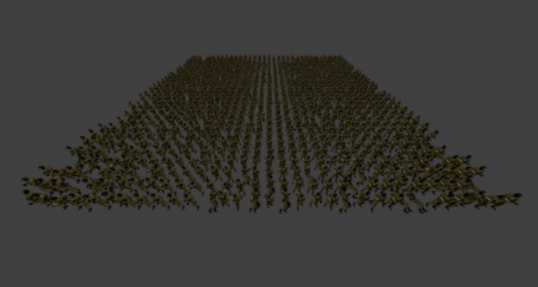
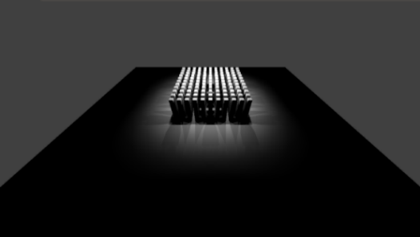
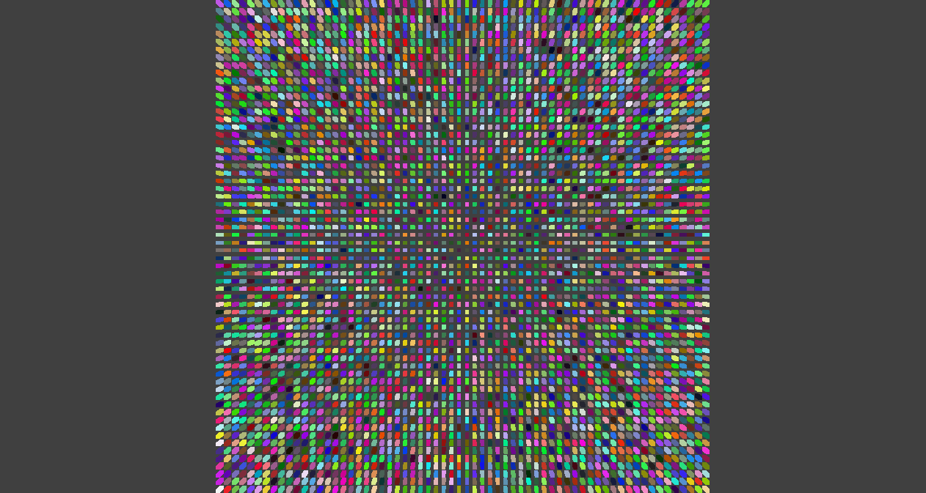
Results
Benchmarks
  Simple stress tests designed to demonstrate common bottlenecks
  Duplicated in new Vulkan renderer (Ultra Engine), Leadwerks 4.6 (OpenGL), and Unity 2020.3.15f2 (DirectX 11 and Vulkan)
Test Machine
  Nvidia GeForce 1080 GTX GPU with driver 471.41
  Intel Core i7-7700K CPU @4.20 GHz
  Windows 10

Slide 17
Results
Instanced geometry test
  3D grid of 32,768 instanced cubes is created
  Evaluates how the renderer handles a large number of objects with CPU frustum culling enabled

Slide 18
Results
Animation test
  1024 individual animated characters are displayed
  All unique animations, no instanced data

Slide 19

Results
Lighting test
  25 point lights
  968 instanced boxes
  Simulates a complex scene with many lit objects

Slide 20
Results
Unique geometry test
  4096 unique boxes
  Simulates a complex scene with many unique objects

Slide 21
Results
Instanced geometry test
  New renderer outperforms both Leadwerks and Unity by 20x
a | GPU Utilization | Framerate
Leadwerks (OpenGL) | 8% | 52
Unity (DX11) | 4% | 40
Unity (Vulkan) | 4% | 40
Ultra Engine (Vulkan) | 95% | 1206

Slide 22
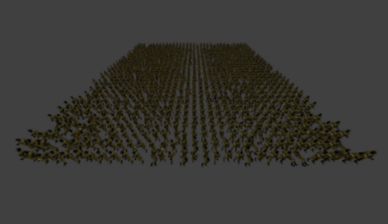
Results
Animation test
  New renderer outperforms Leadwerks by 200x
  New renderer outperforms Unity by 18x
 | GPU Utilization | Framerate
Leadwerks (OpenGL) | 1% | 5
Unity (DX11) | 45% | 62
Unity (Vulkan) | 45% | 64
Ultra Engine (Vulkan) | 96% | 1179

Slide 23
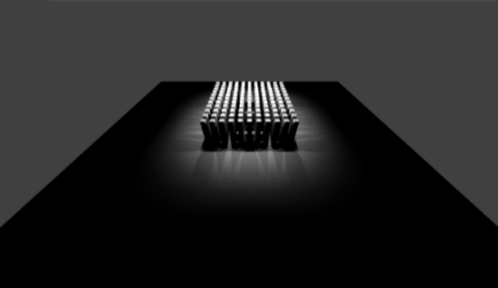
Results
Lighting test
  New renderer outperforms Leadwerks by 2x
  New renderer outperforms Unity by 16x
 | GPU Utilization | Framerate
Leadwerks (OpenGL) | 49% | 704
Unity (DX11) | 33% | 90
Unity (Vulkan) | 30% | 74
Ultra Engine (Vulkan) | 96% | 1456

Slide 24
Results
Unique geometry test
  New renderer outperforms Leadwerks by 100x
  New renderer outperforms Unity by 3000x
 | GPU Utilization | Framerate
Leadwerks (OpenGL) | 10% | 49
Unity (DX11) | 5% | 2
Unity (Vulkan) | 4% | 2
Ultra Engine (Vulkan) | 63% | 6213

Slide 25
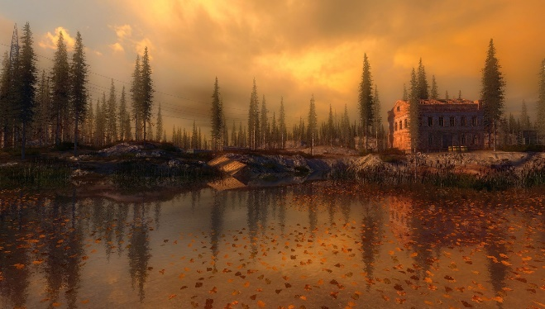
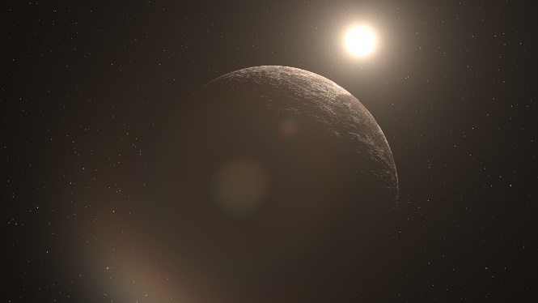
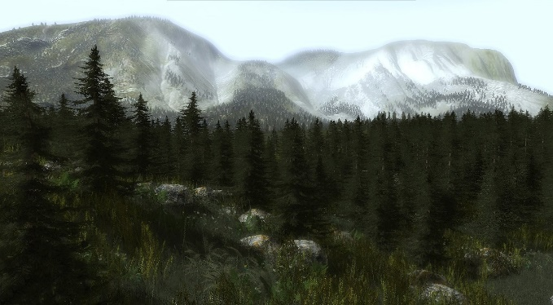
Conclusions
Changes in graphics hardware and faster refresh rates of VR headsets require a new approach to renderer design
Maximizing GPU utilization resulted in performance an order of magnitude faster than both Leadwerks and Unity, under a variety of usage scenarios
Can be used to eliminate VR motion sickness and lower hardware costs

